Slide 1


Welcome

Slide 2
FIRST Robotics Competition (FRC)
Introduction
FIRST at a Glance
Team Details
Competitive Season
Caterpillar Guidelines
Multimedia
Next Steps

Slide 3
Introduction
Lance Wright – Team Lead
Caterpillar, Inc
South Dakota School of Mines & Technology– BSME
Wayne Baumberger – CAT Advisor
Caterpillar, Inc
South Dakota School of Mines & Technology– BSME

Slide 4
Introduction
Vision
Students, parents, and the community will regard the team as the premier local extracurricular activity. We will promote continuous learning throughout the students’ educational career, higher education and professional careers.
Mission
The team will provide mentor support and leadership to focus and foster students’ natural curiosities and ingenuity on a technical challenge that requires teamwork, commitment, and personal growth. By building a competitive robot in a compressed time frame within real life constraints, students will gain an understanding and respect for engineering and technical pursuits. These experiences will teach the students that technical challenges are not only fun but also extremely rewarding.

Slide 5
Introduction
Mentoring
8 Caterpillar Professionals volunteering their time
Mentors and students are equal and become united through a partnership. Each works collaboratively toward a mutual and beneficial goal. On a FIRST team, a mentor’s goal should be to actively share his/her knowledge and experiences with the team to help foster intellectual growth. Provide students with opportunities to make choices, both good and bad.
Learning
I Do You Watch
I Do You Help
You Do I Help
You Do I Watch

Slide 6
FIRST at a Glance
FRC
  Founded 1989 by Dean Kamen
  2,700 teams (projected)
  54,000 high-school students
  57 Regional Events; 1 State Championship; 1 Region Championship; 17 District Competitions
  Robots are built in 6 weeks from a common kit of parts provided by FIRST, and weigh up to 150 lbs
Nearly $15 Million in 2013 Scholarship Opportunities

Slide 7
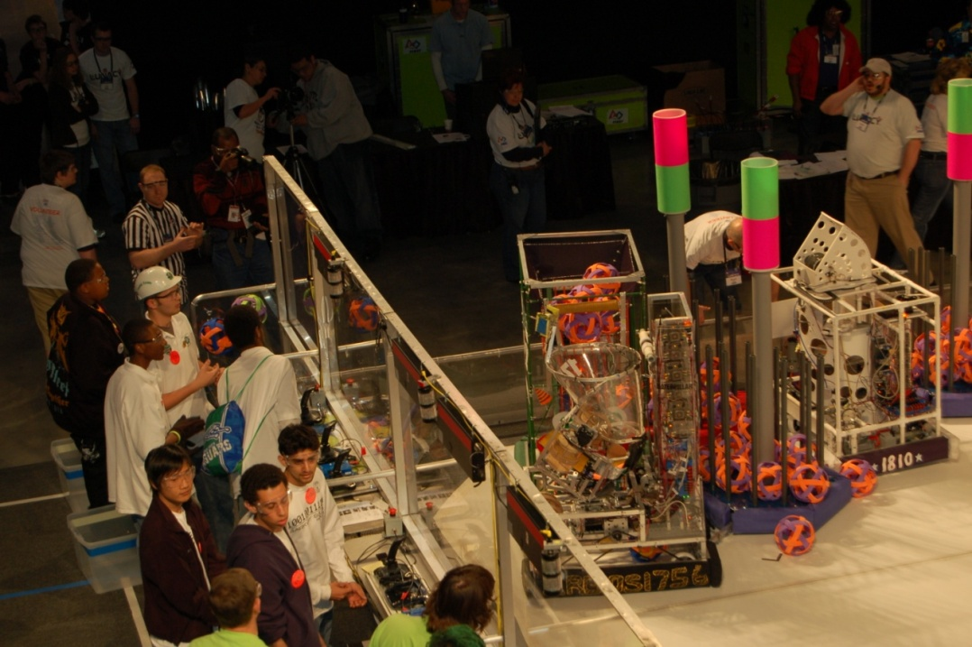
Team Details
Fall Activities (1-2 days/week) – Building a Team
  Training for competitive season
    Engineering Process
    Programming
    3D modeling
Competitive Season (5 days/week)
  6 weeks, 1/5/13 to 2/16/13

Slide 8
Competitive Season
Competitive Season
  Students must maintain grades. School comes first, FIRST will always be an extracurricular activity.
  The Team will meet 5 days per week – Monday, Tuesday, Wednesday, Thursday and Saturday.
    Example Schedule:
      Weekdays 6:00 PM – 9:00 PM
      Weekend 8:00 AM – 2:00 PM
  Students are required to actively participate at each team meeting. Every meeting is a working meeting and if you do not know what to do, then you must ask a mentor.
Regional Competition (Denver, CO – 4/4/13 to 4/6/13)
  Students must maintain a 3 day per week average attendance in addition to the competitive season requirements.
National Competition (St. Louis, MO – 4/24/13 – 4/27/13)
  Students must win their Regional Competition

Slide 9
Competitive Season
What: FIRST Worldwide Kickoff and NASA Live Feed
When: January 5, 2013
Where: Steven High School
After this kickoff we have 6 weeks to design, build, and test our robot.

Slide 10
Caterpillar Guidelines
Students and mentors must sign waivers
At any meetings or events there must be at least 2 mentors in the room at all times
No mentor may give out personal phone numbers or email addresses
No mentor may give any student a ride in his/her vehicle

Slide 11
Multimedia
2008FRC_Overview_LANWM.wmv

Slide 12
Next Steps
Students
  15-20 fully committed students that will attend competition
  Additional students to help support team
Parents
  Provide transportation for students to/from meetings
  Support students commitment to the team
Mentors
  Engineering
  Non Engineering Mentor Organization (NEMO)
    Communicate scholarship opportunities
    Media (photos, videos, logo, posters, buttons, etc)
    Coordinate food/snacks, travel plans for competition

Slide 13
Next Steps
Mentor Organization Chart
Team Lead
Technical Leads
NEMO Leads
Electrical
Controls
Media
Software
Programming
Web Site
Mechanical
Frame/Drive Train
Scholarships

Slide 14
Summary
Need 15-20 committed students
Identify mentors/leads for technical and non-technical support
Begin meeting within 2 weeks

Slide 15
Questions?
Lance Wright
wright_lance@cat.com
(605)-858-5206 Cell/FRC Updates
(605)-388-5690 Office

